Slide 1
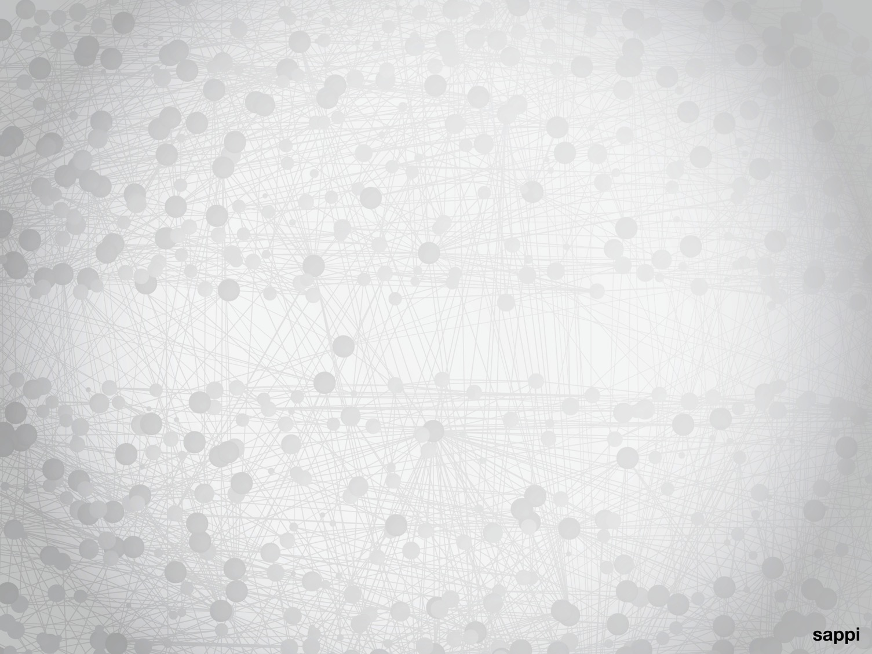
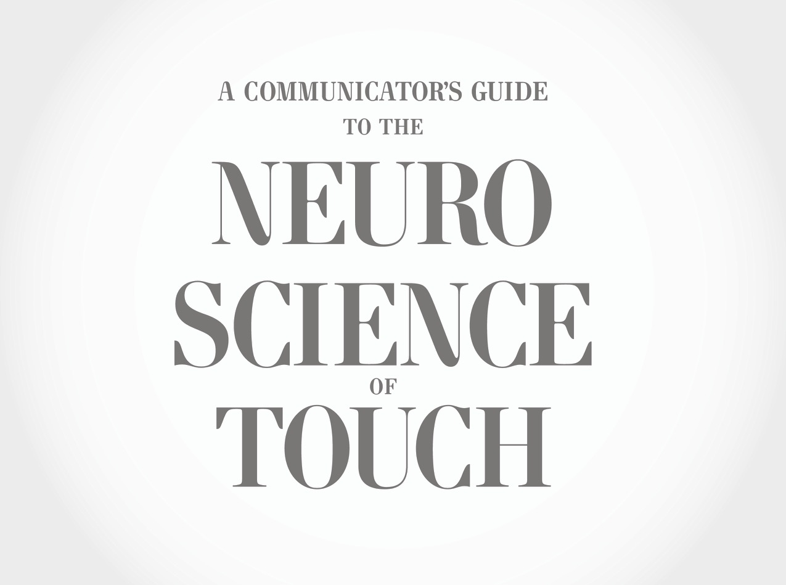

Slide 2

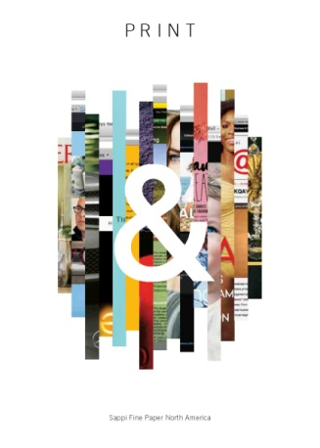
Print & (2013)

Slide 3





Slide 4
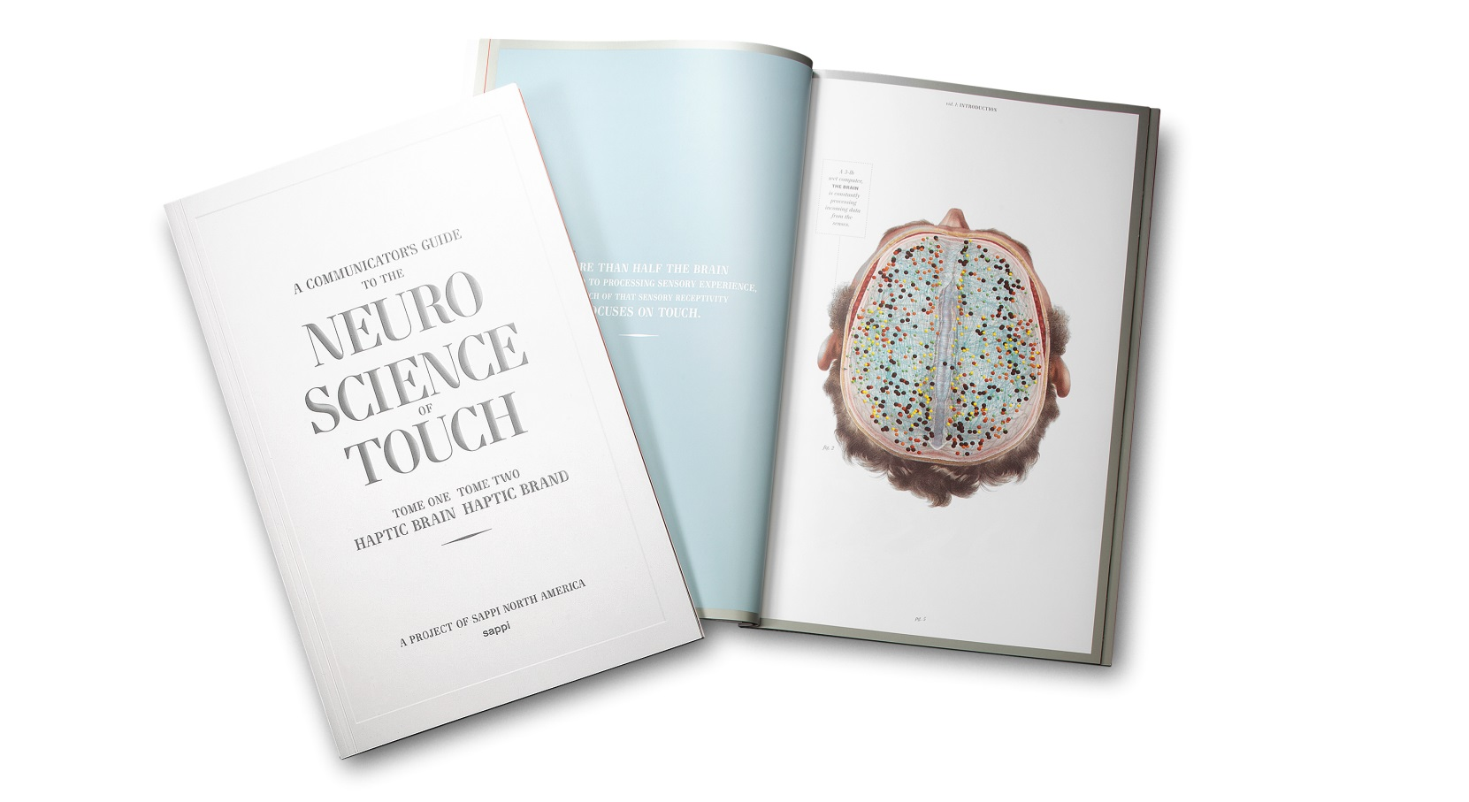

Slide 5
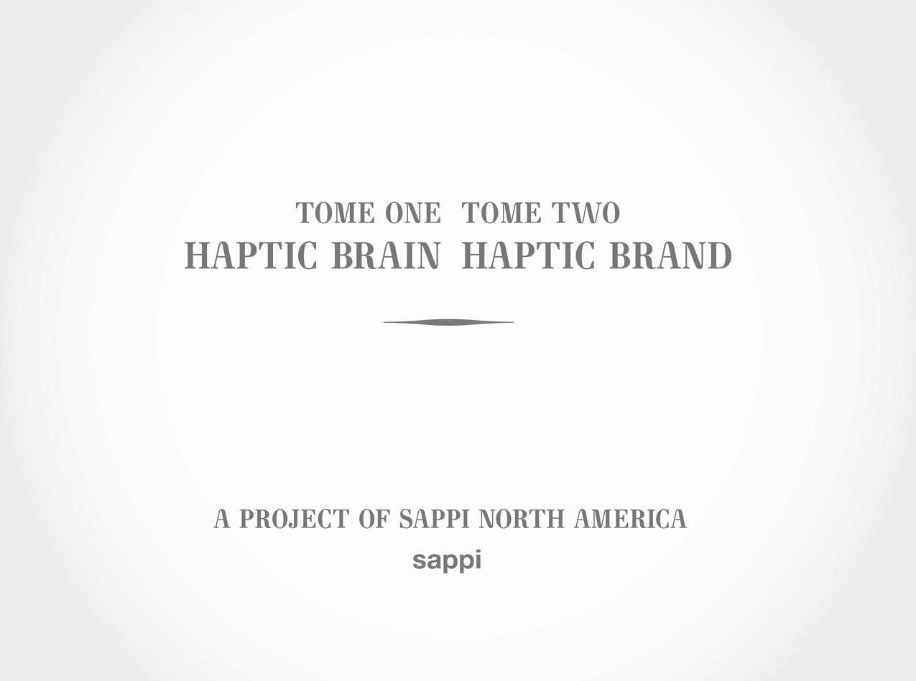

Slide 6
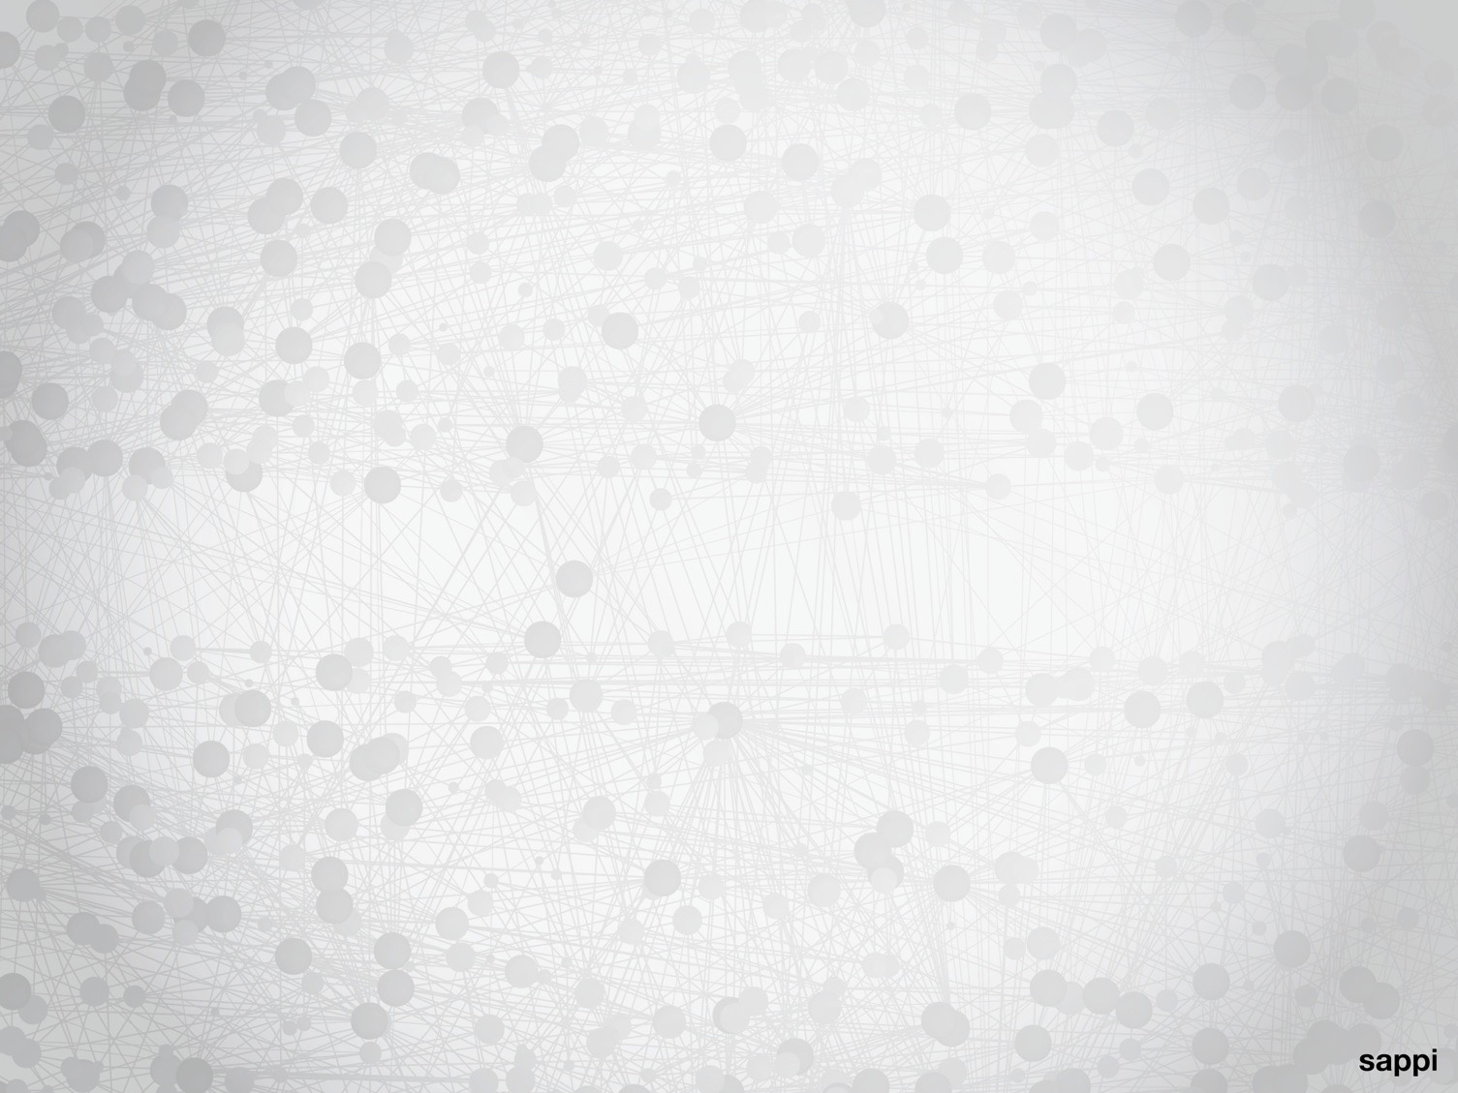
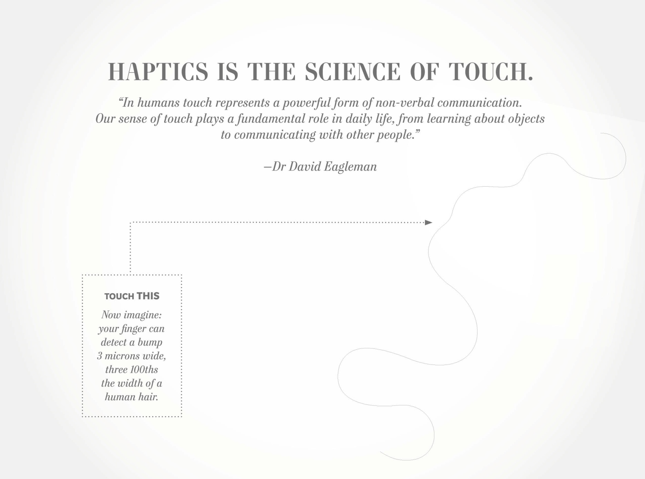

Slide 7
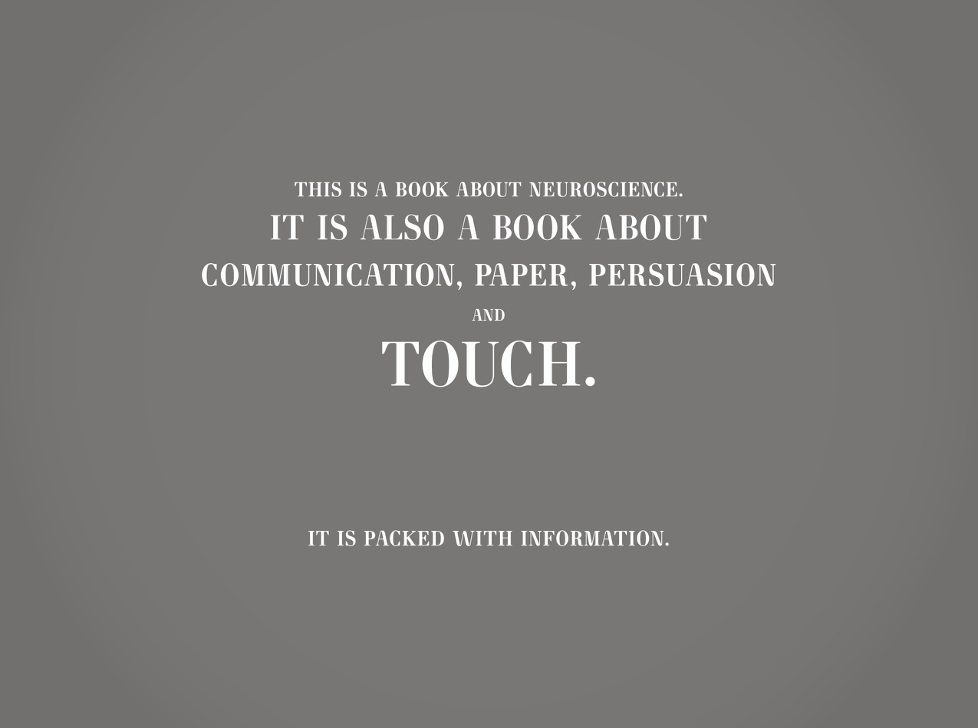

Slide 9
Layar

Slide 10


Slide 11
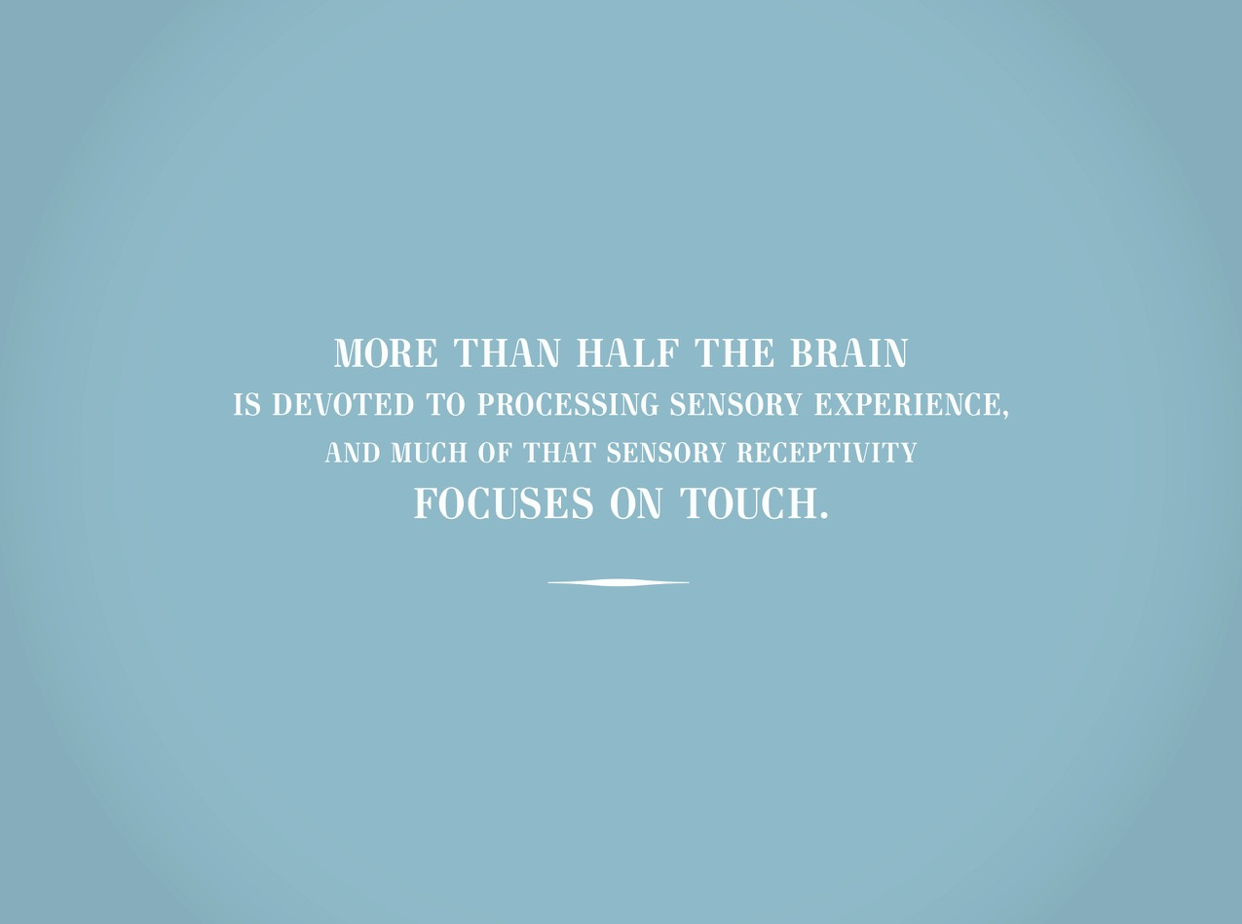

Slide 12
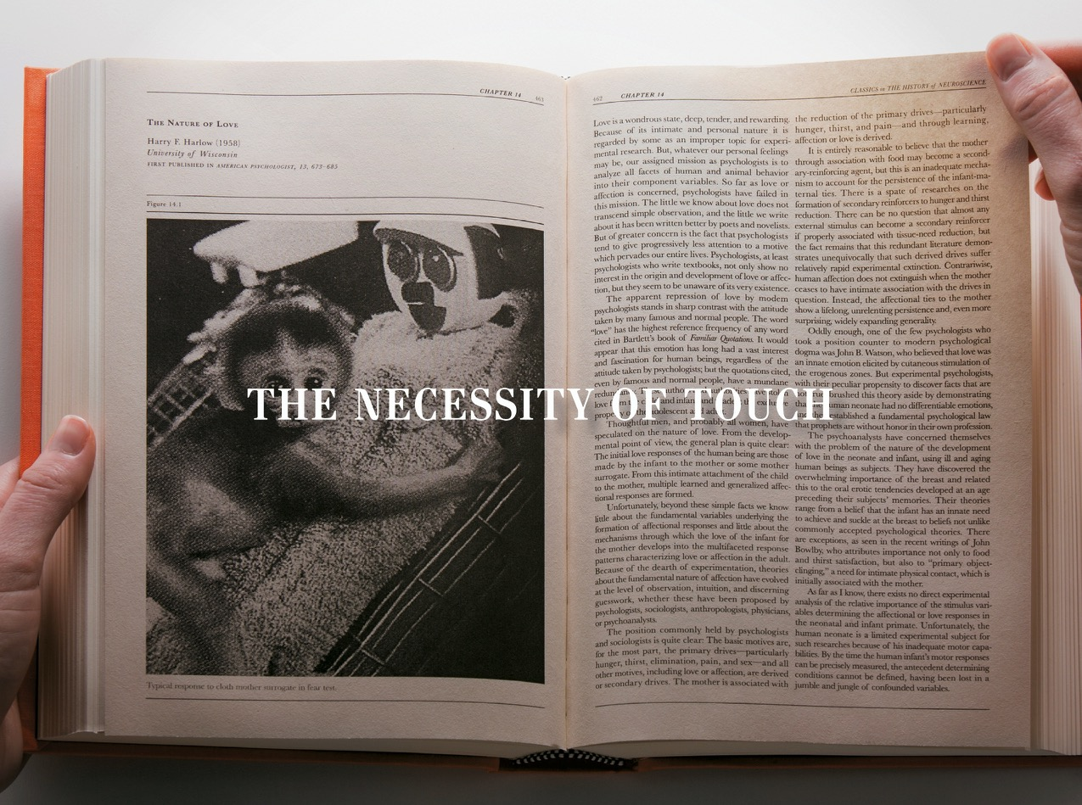

Slide 13
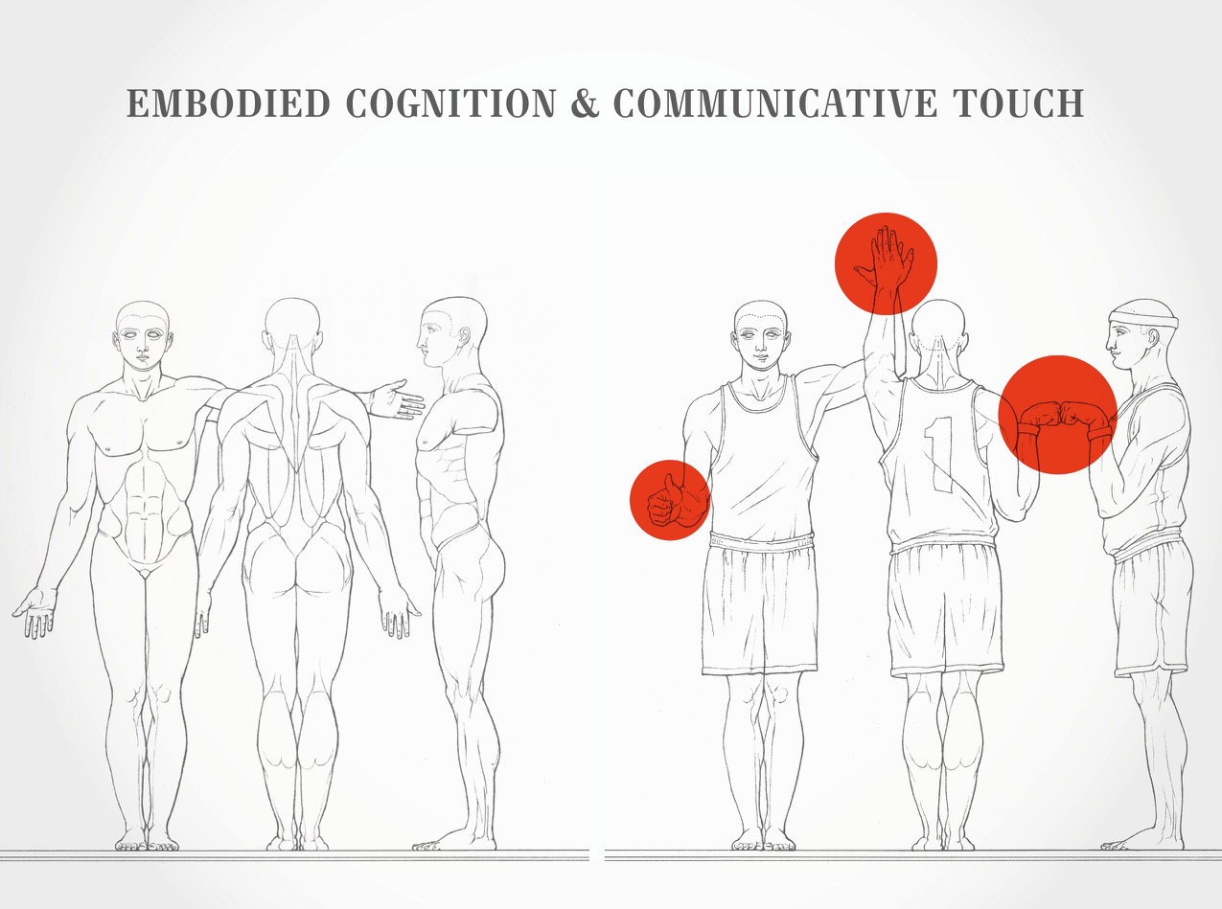

Slide 14

Endowment Effect & Valuation

Slide 15
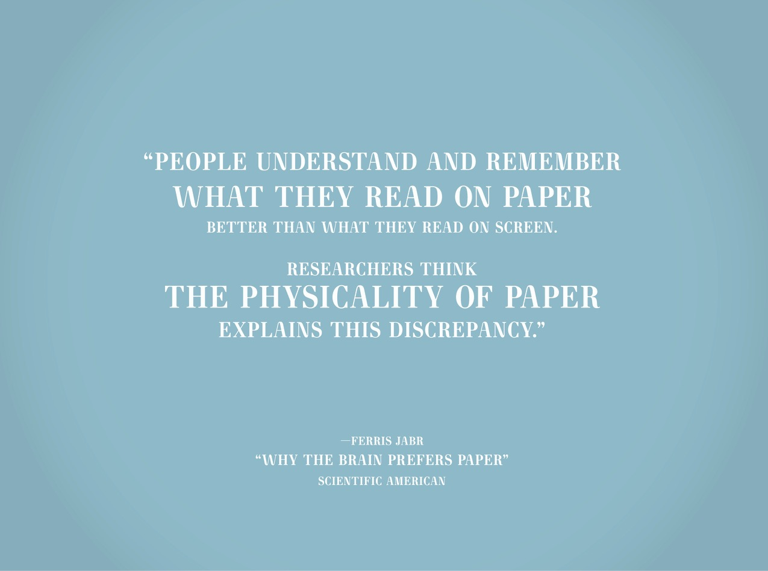

Slide 16
Riepl’s Law
New, further developed types of media
never replace the existing modes of media
and their usage patterns.
Instead, a convergence takes place in their field,
leading to a different way and field of use for these older forms.
The old doesn’t necessarily die out.
In some instances, the old methods are absorbed
or recycled into a new form.
In others cases, those methods are refined
and distilled down to their essence.
In 1913, Wolfgang Riepl, chief editor Nuremburg Daily

Slide 17
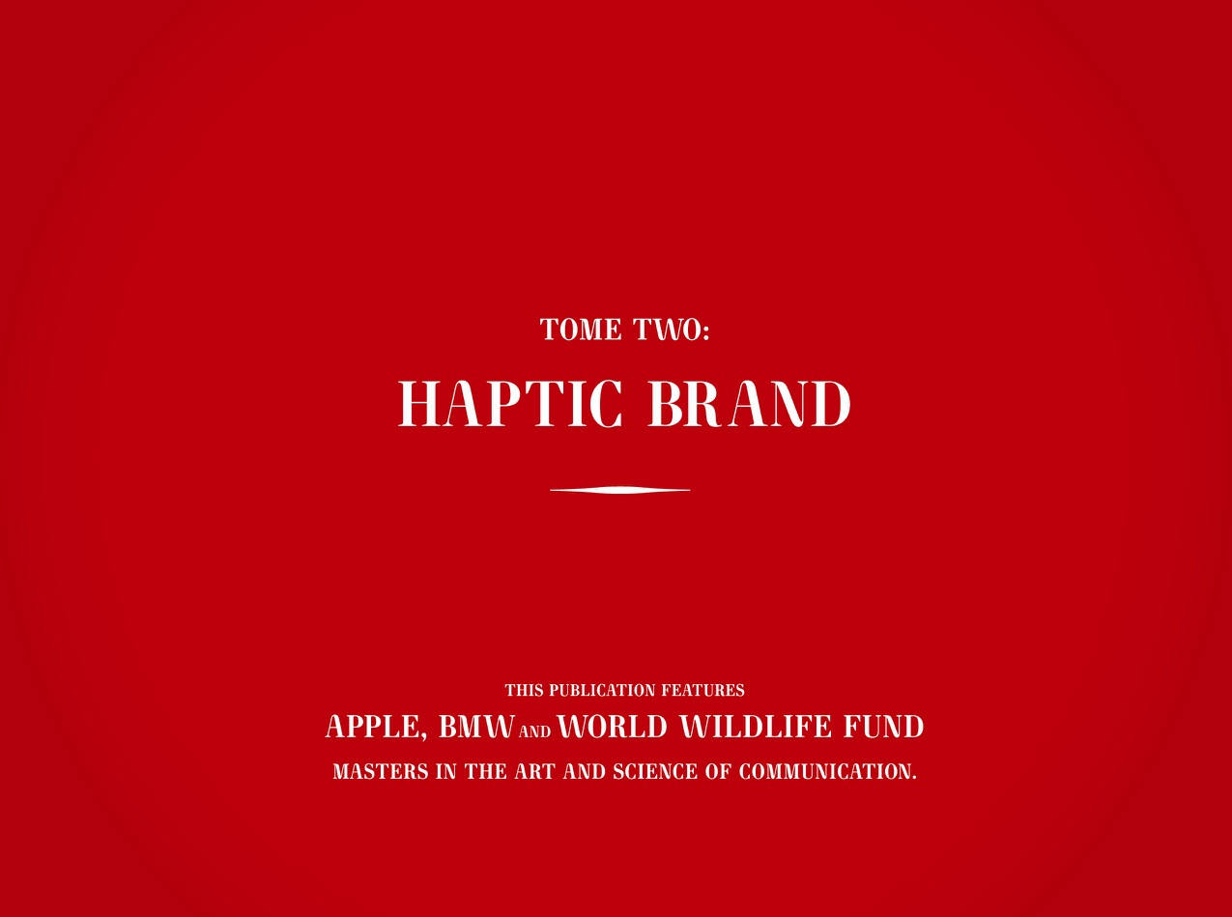

Slide 18
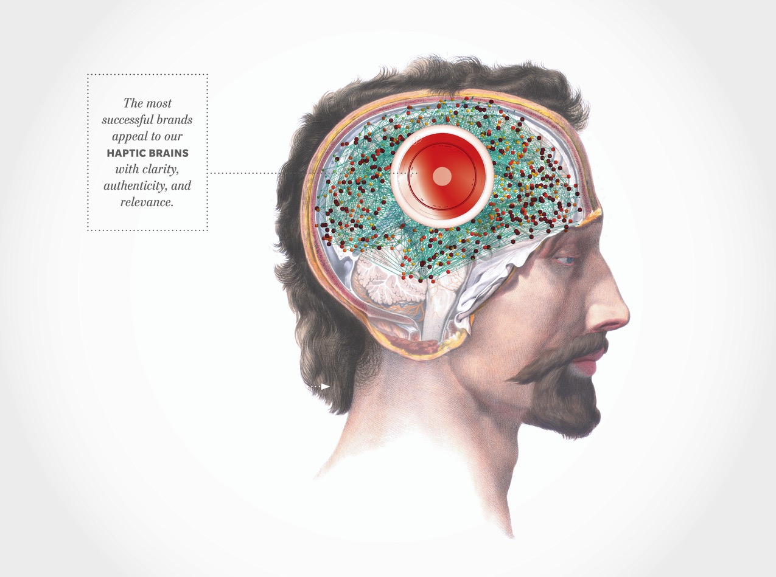

Slide 19
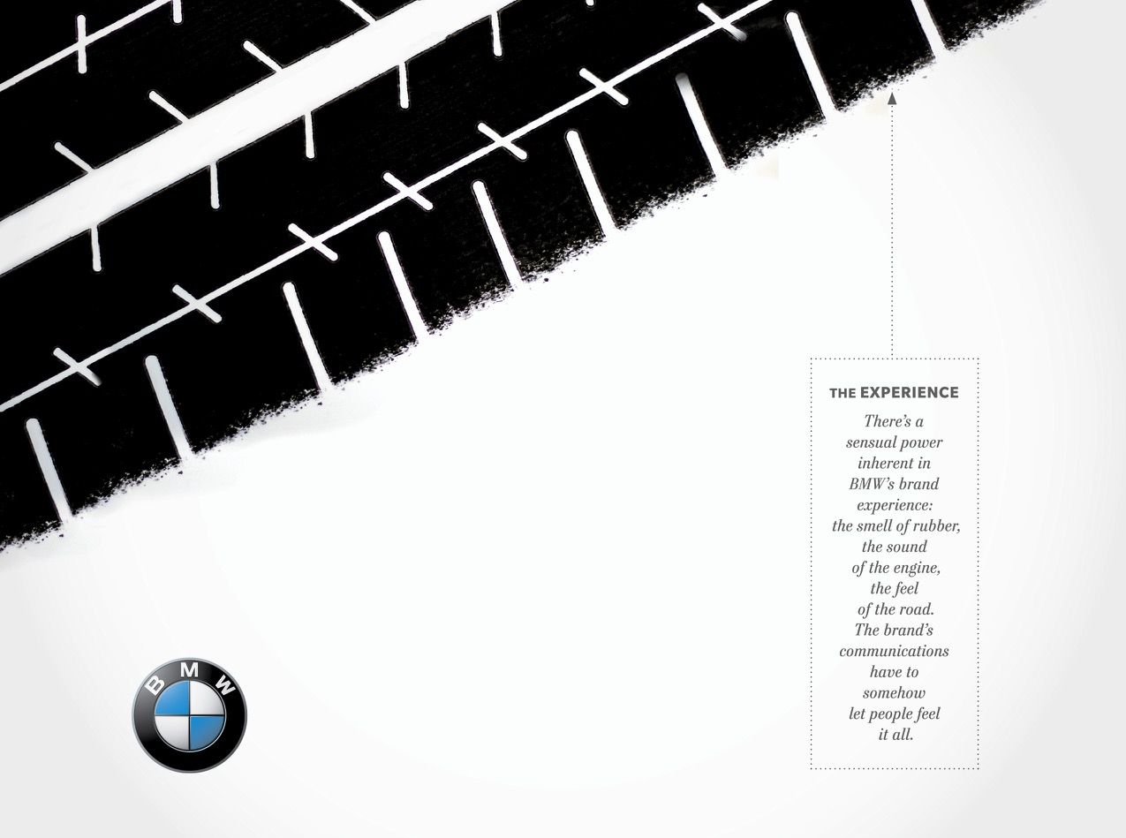

Slide 20
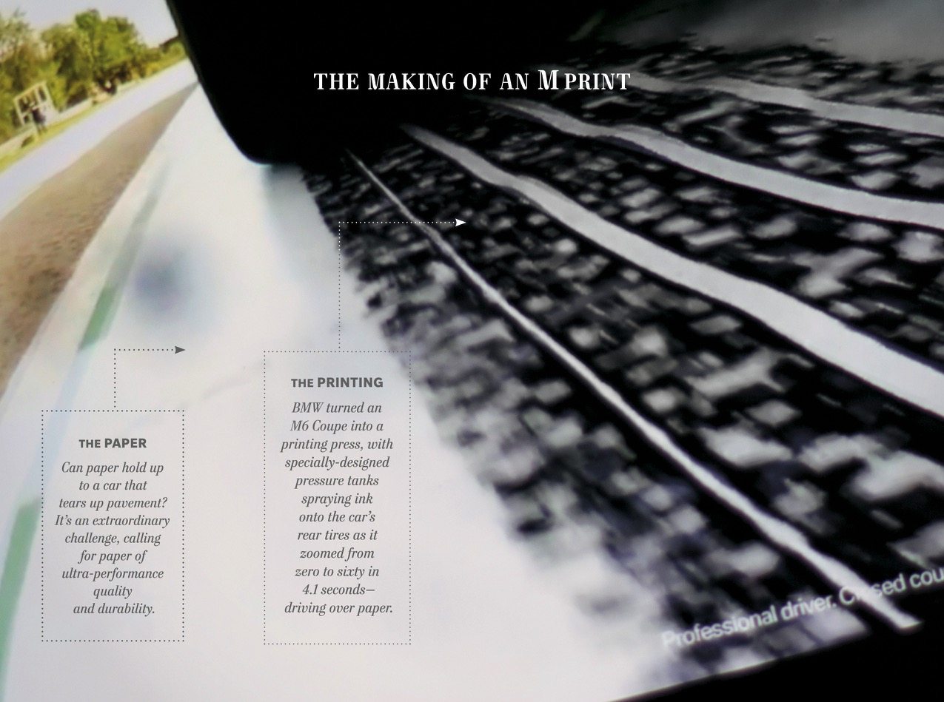

Slide 21
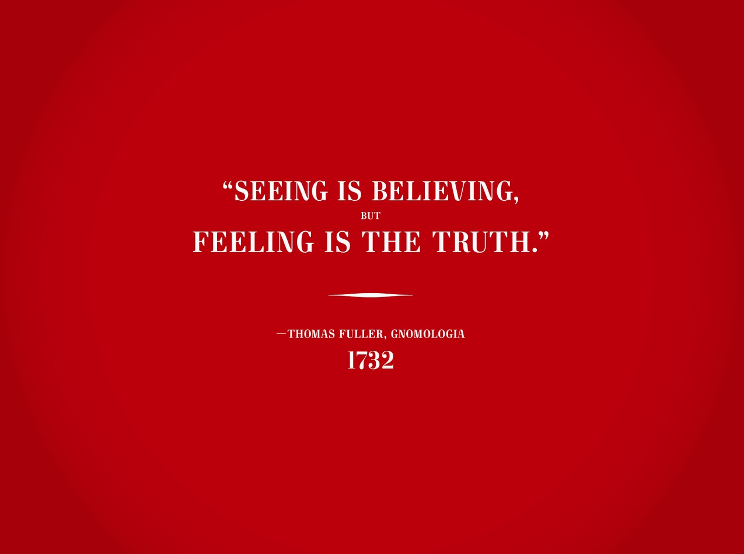

Slide 22

Thank You!
© 2015 Sappi Fine Paper North America. All Rights Reserved.

Slide 23
